Slide 1




Learn the concepts behind 10 Java Challenges and Eliminate Stressful Bugs!
@bazza_ni
http://sli.do #LJC0618

Slide 2



Get to know me...
Barry Evans
Made in (N) Ireland
Live in Dublin
Java == ☺ since 2007
Consultant @ Version 1
DubJUG.org
Java 8 SE OCP Certified
💚 Clean Code & TDD
💔 Bugs & Untested Code
http://sli.do #LJC0618

Slide 3

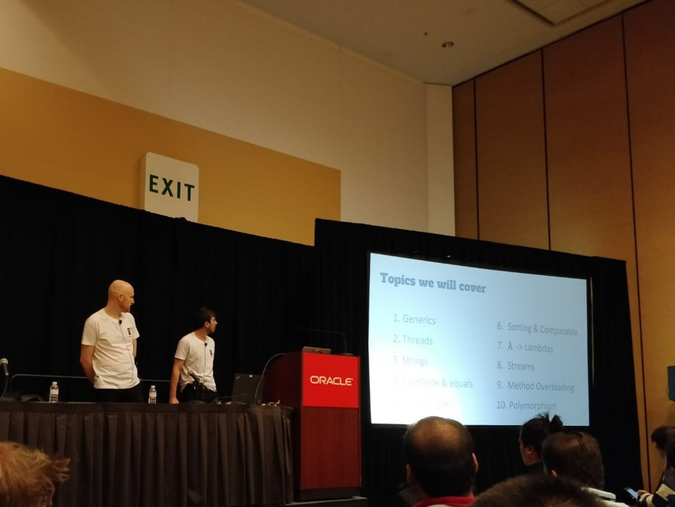
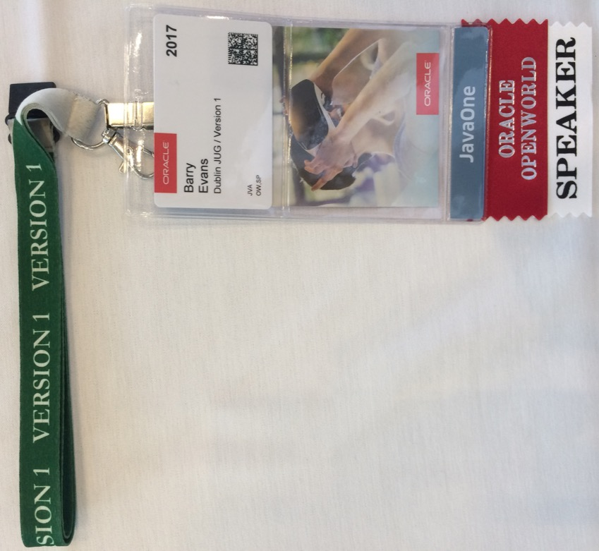
Java Challenges 1.0 @ 2017
http://sli.do #LJC0618

Slide 4
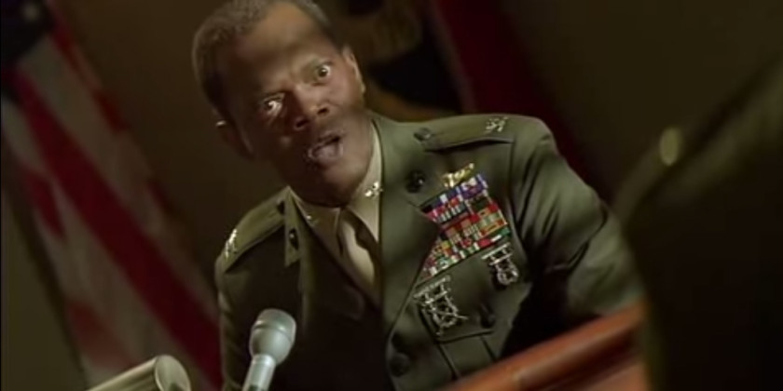
Rules of engagement
Yes, those bugs deserved to be found…
and I HOPE THEY ROT IN HELL!
https://taskandpurpose.com/4-things-veterans-hate-movies-get-wrong/

Slide 5
Rules of engagement
1. 4 x Multiple-choice answers
2. 2_{m} 30_{s} per Challenge
4. Prize for the most correct answers
3. Teams of two

Slide 6
What’s on the Challenge Menu… Part I
1. Generics
2. Strings
3. Crazy Syntax
4. 𝝺 -> Lambdas
5. Method Overloading
6. Threads
7. equals & hashCode
8. Sorting & Comparable
9. Streams
10. Polymorphism
http://sli.do #LJC0618

Slide 7
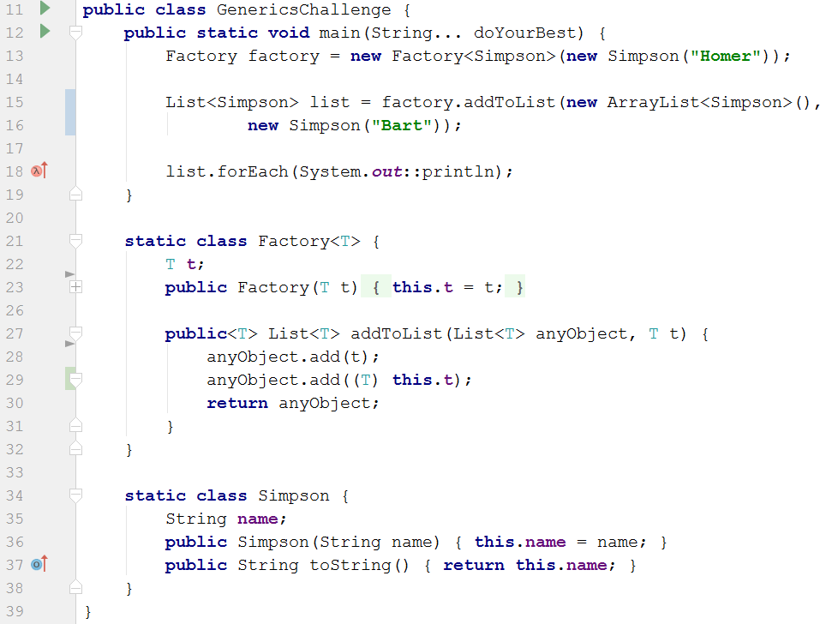
Generics #1
Generic Type Parameters
A) It will not compile
B) Homer
Bart
Type Parameter Scope
C) RuntimeException
at line 29
Shadowing
D) Bart
Homer
D) Bart
Homer
Notes:
Generic Type Parameter
Generic Type parameter scope → Class/Method
Explain the generic type in the class
Explain the generic type in the method

Slide 8
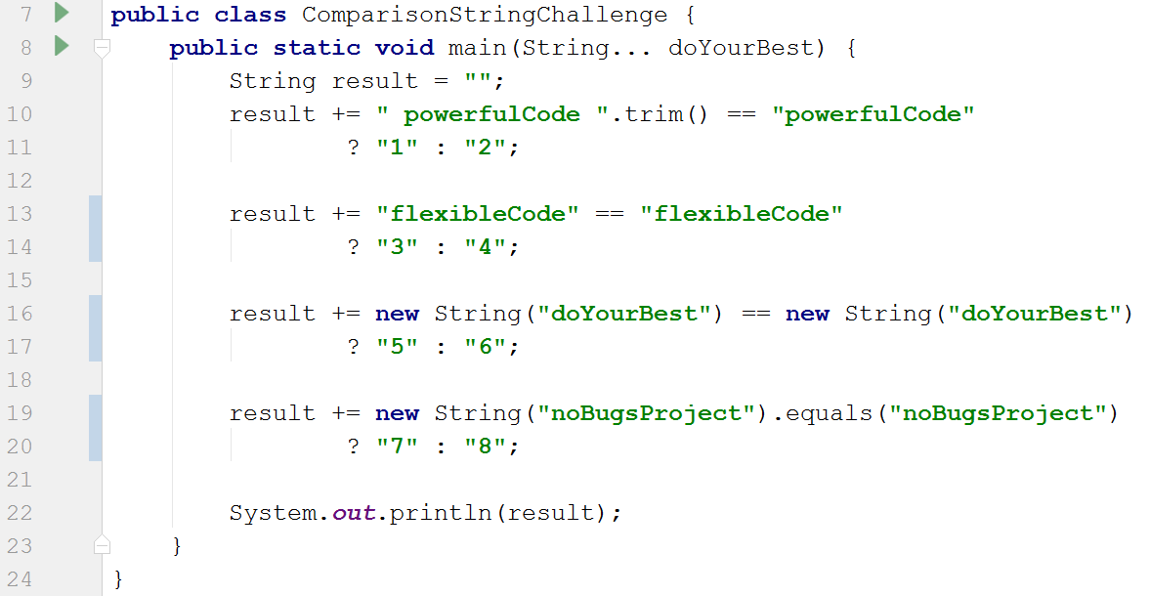
Strings #2
String Pool
Immutable Strings
== != equals
A) 2367
A) 2367
B) 2357
C) 2368
D) 1457
Notes:
String pool
Immutable String
== != equals
TODO
Align all ternary returns – e.g. ? “3” : “4”

Slide 9
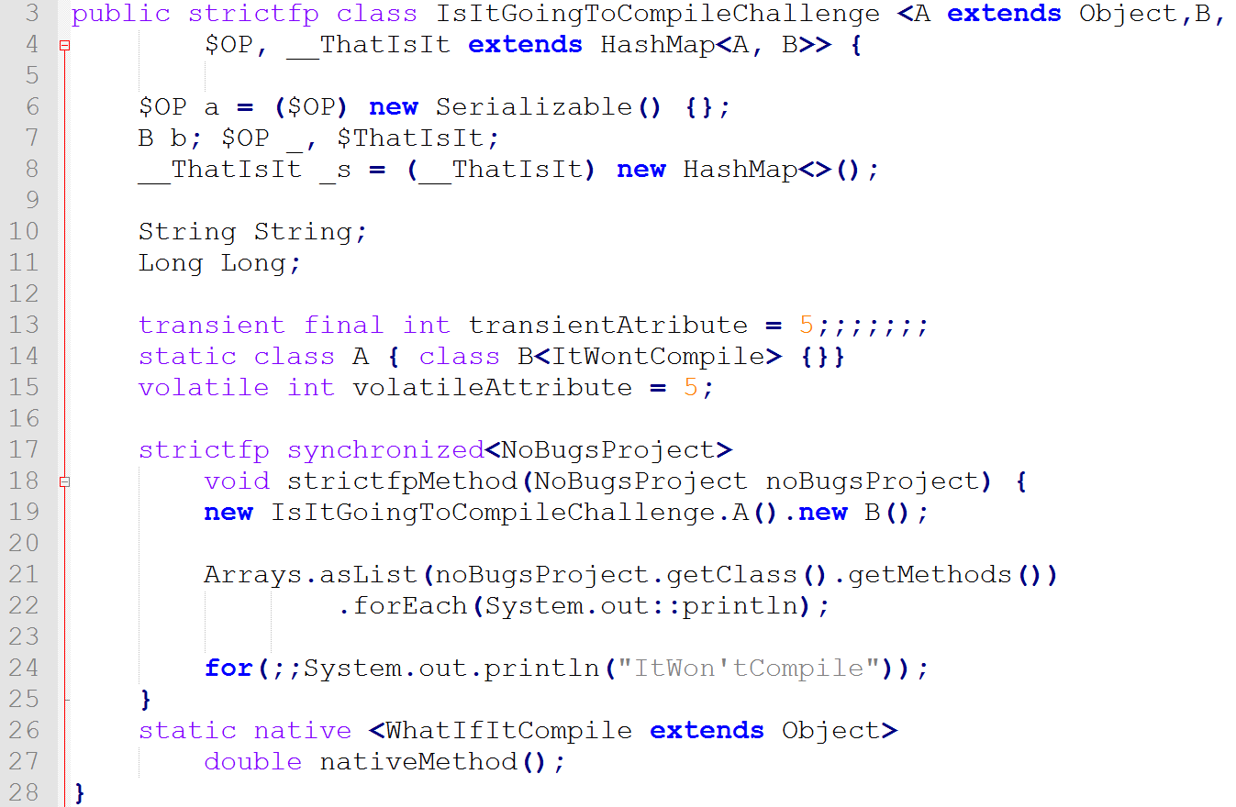
Crazy Syntax #3
Generic Type declarations
Variable names
Uncommon reserved words
for loop structure
A) It won’t compile at line 4
B) It won’t compile at line 10 and 11
C) It won’t compile at line 13 and 24
D) It will compile
D) It will compile
Notes:
For structure
Variable names
Generic types declarations

Slide 10
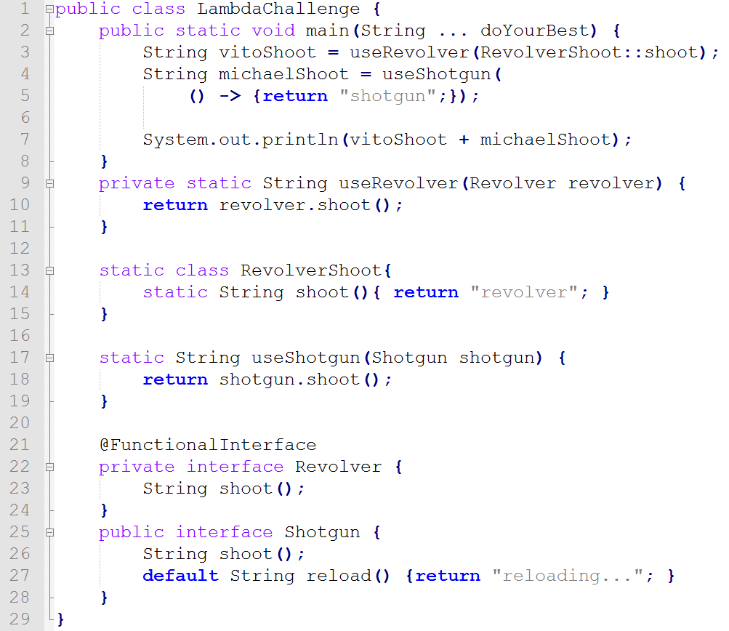
𝝺 -> Lambdas #4
Functional Interface
Default Methods
Lambda Syntax
Method Reference
A) It won’t compile
at line 3.
B) It won’t compile at line 4.
C) revolvershotgun
C) revolvershotgun
D) It won’t compile at line 26
Notes:
Functional Interface
Default methods
Lambda syntax

Slide 11
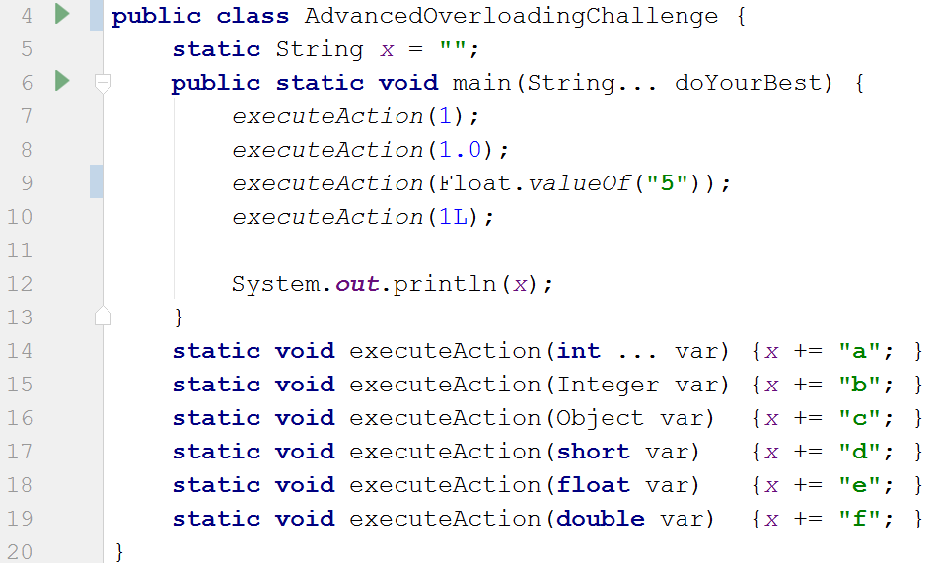

Method Overloading #5
Widening
Boxing
Var args
A) befe
B) efce
B) efce
C) bfce
D) aecf
1 - Widening 2 - Boxing 3 - Boxing+varargs
Notes:
Widening
Boxing
Varargs
TODO
- line up the var keywords

Slide 12

End of Part I…
Learn the concepts behind 10 Java Challenges and Eliminate Stressful Bugs!
http://sli.do #LJC0618

Slide 13
What’s on the Challenge Menu… Part II
1. Generics
2. Strings
3. Crazy Syntax
4. 𝝺 -> Lambdas
5. Method Overloading
6. Threads
7. equals & hashCode
8. Sorting & Comparable
9. Streams
10. Polymorphism
http://sli.do #LJC0618

Slide 14
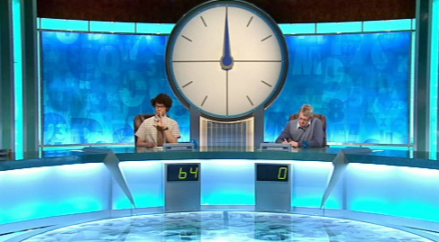
Time to turn the heat up…
http://theitcrowd.wikia.com/wiki/The_Final_Countdown

Slide 15
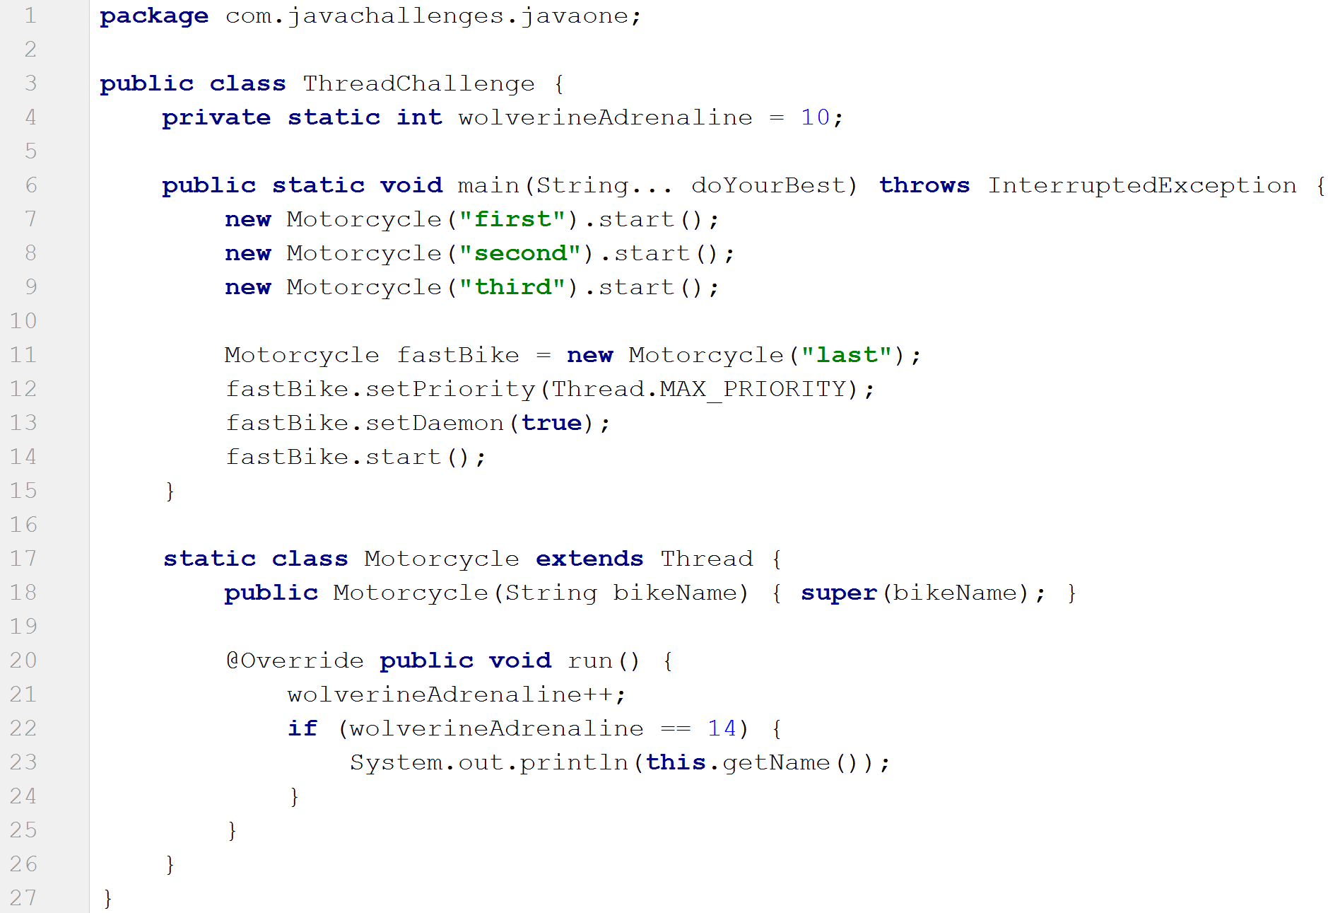
Threads #6
Thread Execution Order
Thread Priority
Daemon Threads
A) first
B) third
C) last
D) Indeterminate
D) Indeterminate
Notes:
Thread execution order is indeterminate
Thread priority is only a preference
Daemon threads will not keep the jvm alive
No output is possible
System.exit(0) | Runtime.exit(0) or All threads that are not daemon threads have died
cd /c/dev/projects/javaone-challenges/target
clear;java -cp classes com.javachallenges.ljc.ThreadChallenge
clear;java -cp classes com.javachallenges.ljc.ThreadChallenge;java -cp classes com.javachallenges.ljc.ThreadChallenge;java -cp classes com.javachallenges.ljc.ThreadChallenge;java -cp classes com.javachallenges.ljc.ThreadChallenge;java -cp classes com.javachallenges.ljc.ThreadChallenge;java -cp classes com.javachallenges.ljc.ThreadChallenge;java -cp classes com.javachallenges.ljc.ThreadChallenge;java -cp classes com.javachallenges.ljc.ThreadChallenge

Slide 16
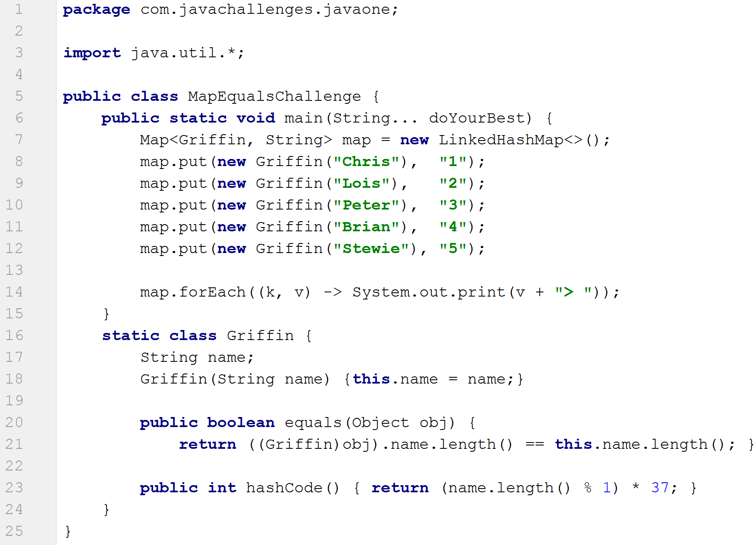
equals & hashCode #7
HashMap : equals/hashCode
LinkedHashMap
Map.forEach → BiConsumer
A) 1> 2> 3> 4> 5>
B) Indeterminate
8
C) 4> 2> 5>
C) 4> 2> 5> Brian Lois Stewie
D) 5> 4> 3> 2> 1>
Notes:
HashMap uses hashcode, then equals to find unique entries
Hashcode will be used 1st time, then equals
LinkedHashMap will guarantee the iteration order
Reinsertion of same key does not affect insertion order
cheaper than TreeMap
Map.forEach uses BiConsumer (accept)
java 8 feature
LHM has its own implementation
… Meg

Slide 17

equals & hashCode #7
X
A) 1> 2> 3> 4> 5>
B) Indeterminate
C) 4> 2> 5> Brian Lois Stewie
C) 4> 2> 5>
D) 5> 4> 3> 2> 1>
Notes:
Nobody likes Meg

Slide 18
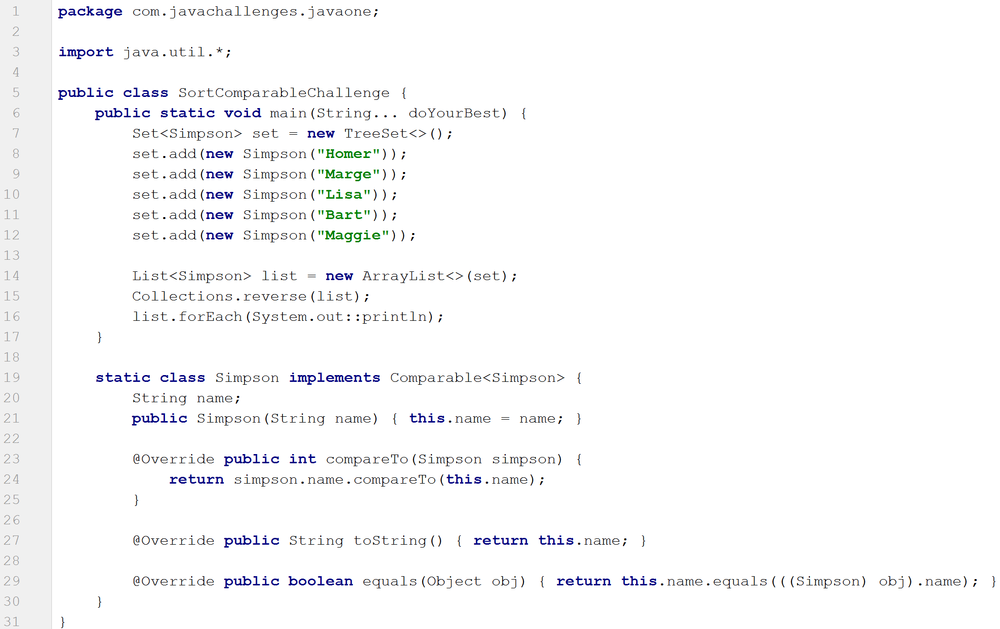
Sorting & Comparable #8
TreeSet
Comparable<?> interface
ArrayList.forEach → Consumer
TreeSet & Equals
A) Bart
Homer
Lisa
Maggie
Marge
A) Bart Homer Lisa Maggie Marge
8
B) Marge Maggie Lisa Homer Bart
8
C) Maggie Bart Lisa Marge Homer
D) Indeterminate
Notes:
TreeSet
Natural ordering or Comparator (as a lambda)
Comparable<?> interface
Can be sorted automatically
compareTo provides reverse alpha order
TreeSet & Equals
Not used for ordering elements
Should be consistent with equals
ArrayList.forEach uses Consumer (accept)
Lambda or method reference
TreeSet – with a Comparator lambda
8 calls
Homer,Homer
Homer,Marge
Homer,Lisa
Marge,Lisa
Lisa,Bart
Homer,Bart
Lisa,Maggie
Marge,Maggie

Slide 19
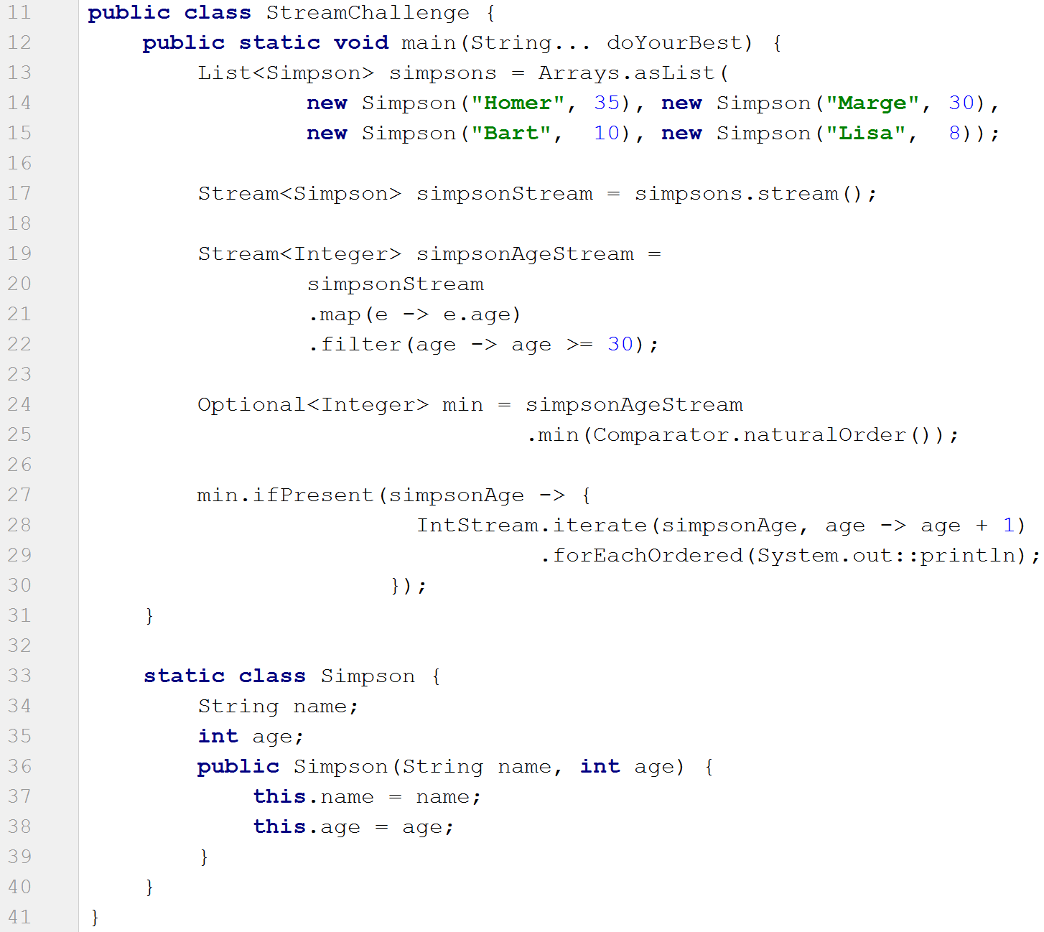



Streams #9
Streams
Optional.ifPresent → Consumer<?>
Terminal Op -> min(Comparator<?>)
Stream.iterate → ∞
Intermediate Ops → map | filter
A) 31
B) Prints to ∞
B) Prints to ∞...
and beyond
C) Prints nothing
D) java.util.NoSuchElementException
Notes:
Streams
No storage | Functional in nature | Laziness-seeking | Possibly unbounded | Consumable
Pipelines
Streams → intermediate operations
Map/Filter | Lazy evaluation
Stream → terminal operation
.min → Comparator<?> or Lambda
Optional.ifPresent → Consumer<?>
Container object which may or may not contain a non-null value
Stream could be empty
Stream.iterate
Infinite stream
Use limit to bound

Slide 20
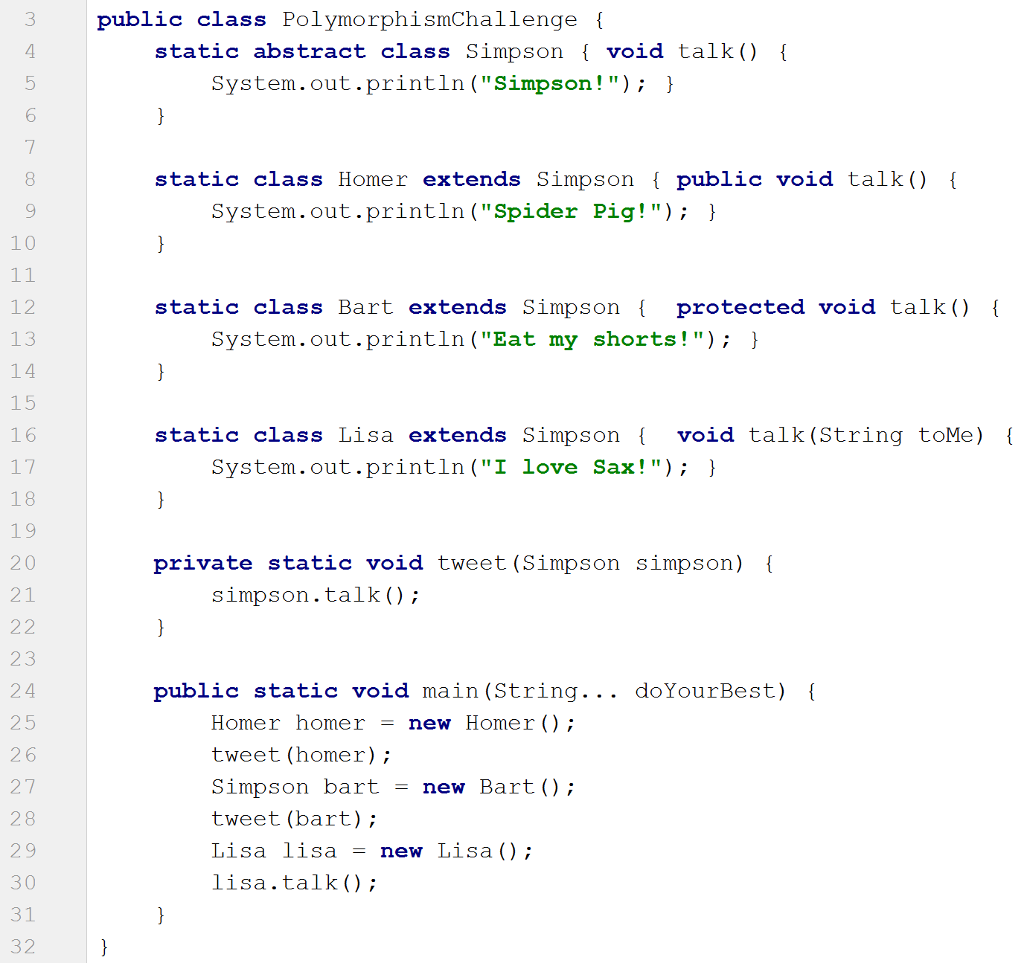
Polymorphism #10
Method Overriding
Method Overloading
Virtual Method Invocation
A) Spider Pig! Eat my shorts! I love Sax!
B) Spider Pig!
Simpson!
I love Sax!
C) Spider Pig! Eat my shorts! Simpson!
private
default (package)
protected
public
C) Spider Pig! Eat my shorts! Simpson!
D) Simpson! Simpson! Simpson!
Notes:
Arguably the most important pillar of OO in a language
Method overriding
Access modifiers
Method overloading
Method signature
Virtual Method Invocation
Object reference is irrelevant
Polymorphism

Slide 21
Topics we covered
1. Generics
2. Strings
3. Crazy Syntax
4. 𝝺 -> Lambdas
5. Method Overloading
6. Threads
7. equals & hashCode
8. Sorting & Comparable
9. Streams
10. Polymorphism
http://sli.do #LJC0618

Slide 22

That’s all folks
Thank you for your time...
Learn the concepts behind 10 Java Challenges and Eliminate Stressful Bugs!
@bazza_ni
http://sli.do #LJC0618

Slide 23
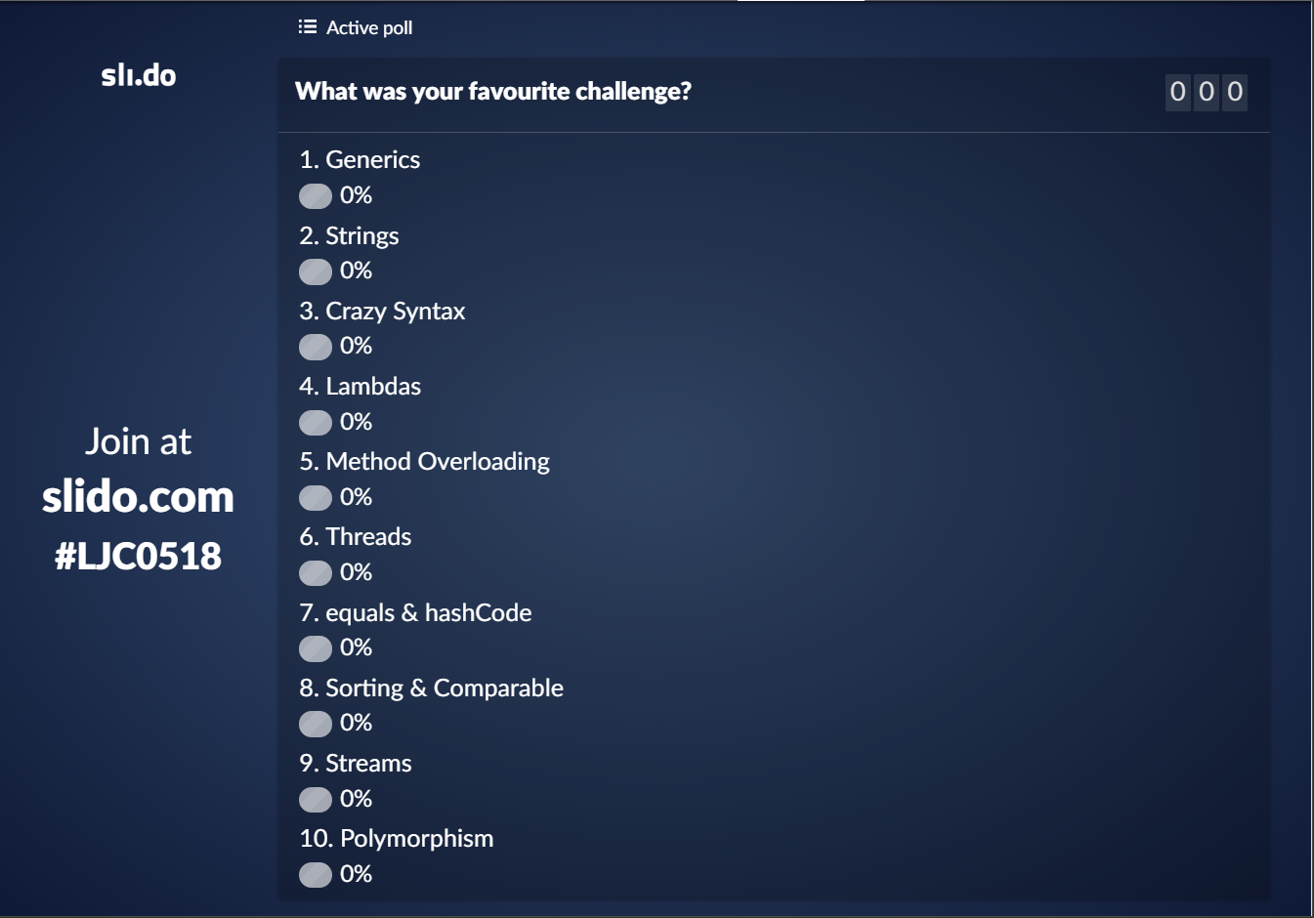

Vote for your favourite challenge @ http://sli.do #LJC0618
Notes:
TODO get new snag of slido

Slide 24
That’s all folks
Thank you for your time...
Learn the concepts behind 10 Java Challenges and Eliminate Stressful Bugs!
@bazza_ni
http://sli.do #LJC0618

